Slide 1
SLA
By: Vijay Kumar V!shan

Slide 2
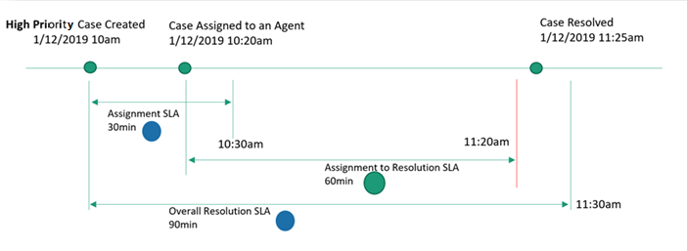
What is SLA?
A service level agreement (SLA) is an agreement between a service company and a service customer. In a SLA, the customer agrees to a minimum response time based on when the service company records the issue and when the issue is resolved.

Slide 3
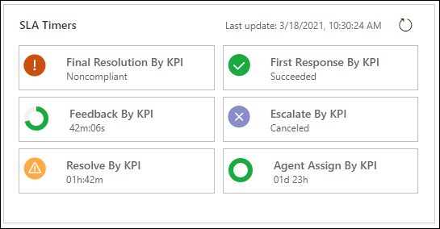
When?
First Response KPI
Resolve By KPI
Agent Assign By KPI
Final Resolution By KPI
Feedback By KPI
Escalated By KPI
etc

Slide 4
Prerequisites
Customer Service module
Have permission (Security Role)
Create permission for SLA, SLA KPI, SLA KPI instances, and calendar
Power Automate License

Slide 5
Configure service-level agreements
Enable SLA for entity
Create SLA KPI
Create SLA
Create calendar for working hours and holidays
Create SLA Items (SLA KPI Instance) in SLA
Create SLA KPI relation with entity
Create or add Timer in entity form

Slide 6
Limitation of SLA
Active SLA for max 7 entities
SLA KPI per entity is 5
Maximum of 100 SLA items per SLA entity
Default SLA limitations
Modification limitation
"Applicable When" and "Success Conditions“ for related entities.
Modified On field
No manual time updates
Etc.

Slide 7
Thank you!!!

